Slide 1


Python: Object-Oriented programming & Libraries.
Presenter
Mohammad Anees Alam
Notes:
1

Slide 2
Topics for today!
1
Intro & deep-dive into OOP concepts
2
Python Libraries
3
Regular Expressions
4
Hands-on activity
Mohammad Anees Alam
Notes:
2

Slide 3
Key OOP Concepts
  Object-Oriented Programming (OOP) is a programming approach that organizes code by using "objects," which are specific instances of classes.
  This method focuses on creating modular and reusable code by grouping related data and functions into objects, making it easier to manage and extend the code.
Class & Object
1
A class is like a blueprint that defines the attributes & methods (functions).
Encapsulation
2
An instance (object) is a concrete realization of that blueprint that holds the data & performs the operations defined in class.
It’s the practice of storing data and, the functions that work with that data together in one class. This keeps the details hidden and only allows controlled access.
3
Ex: Behind the scenes of your software or app.
Inheritance
A mechanism where a new class (child) inherits attributes and methods from an existing class (parent), promoting code reuse.
Polymorphism
4
Allows you to reuse methods or objects from different classes without having to rewrite or recreate the code for each object.
Abstraction
5
Hiding complex implementation details and showing only essential features to the user.
Ex: Referencing objects from different classes.
Ex: Using a TV remote.
Mohammad Anees Alam
Notes:
3

Slide 4
Creating Classes and Objects
  The "Server" class is created with functions inside it.
class Server:
def __init__(self, name, ip_address):
self.name = name
self.ip_address = ip_address
def start(self):
return f"Server {self.name} is starting."
def stop(self):
return f"Server {self.name} is stopping."
# Creating an object of the Server class
server1 = Server("WebServer1", "192.168.0.1")
# Accessing attributes and methods
print(server1.name)
# Output: WebServer1
print(server1.start())
# Output: Server WebServer1 is starting.
  The init method is a special method called the constructor. It is automatically invoked when a new object of the class is created.
  self in constructor refers to the object being created, it allows you to access and modify the attributes and methods of the object.
  When we create a server object with server1 = Server("WebServer1", "192.168.0.1").
Key points:
  Encapsulation: The name and ip_address attributes are encapsulated inside the Server object.
Notes:
4

Slide 5
Inheritance and Method Overriding
Let's analyze a code that demonstrates the use of Inheritance & method overriding.
1
2
3
4
Create Parent Class
Create Child Class
Use Inheritance
Override Methods
  super().__init__(name, ip_address) allows DatabaseServer to initialize the inherited attributes from Server.
  Override the start method to provide custom functionality: def start(self):
  Define the DatabaseServer class that inherits from Server using class DatabaseServer(Server).
  Define the Server class with basic attributes and methods that all servers will share.
  DatabaseServer inherits from Server, gaining its attributes and methods.
  Add the database_name attribute specific to database servers.
Mohammad Anees Alam
Notes:
5

Slide 6





Hands-On Activty
Define the Class
Create a VirtualMachine class with attributes hostname, cpu, and ram and an additional method def start() to define the behavior of the class.
Add Methods
Create a subclass WebServerVM with an additional method host_website and an additional attribute data_name to inherit the behavior of the parent class in this child class.
Create an Object
Create an object of the WebServerVM class.
Use the Methods
Call both inherited and new methods.
Notes:
6

Slide 7





Python Libraries for DevOps Tasks
os and subprocess
boto3
paramiko
ansible
Used for system operations like interacting with the file system, executing commands, and managing processes. Essential for automation scripts.
The AWS SDK for Python that helps manage AWS resources programmatically. Perfect for automating cloud infrastructure tasks.
Used for SSH connections and remote server management, allowing secure execution of commands on remote systems.
Infrastructure automation tool that helps manage servers, configurations, and deployments at scale.
  I encourage you all to refer to this boto3 documentation: https://boto3.amazonaws.com/v1/documentation/api/latest/index.html
Mohammad Anees Alam
Notes:
7

Slide 8
Regular Expressions for DevOps
  Regular expressions (regex) are patterns used to match character combinations in strings.
  In Python, the re module is used for regex operations like search, match, and replace.
1
Key Components
2
Phone Number Extraction
  Literals: match actual characters (a, 1, @).
9846193114 —> ^\d{10}$
  Meta-characters: like ^, $, *, + have special meanings.
  This pattern will match any 10-digit phone number, which is the standard format for Indian mobile numbers.
  Anchors: (^ and $) match the start and end of strings. Character classes: like [a-z] and \d match digits, etc.
^\d{4}[-\s]?\d{3}[-\s]?\d{3}$ —> 9846 193 114
  Groups: () to group parts of the regex and apply quantifiers.(like *, +, ?)
  This pattern allows phone numbers with optional spaces or dashes between the groups of digits.
3
Email Extraction
4
Log Parsing Example
r'[a-zA-Z0-9._%+-]+@[a-zA-Z0-9.-]+\.[a-zA-Z]{2,}' —> sample.mail.id@gmail.com
  Use regex patterns like r'(error|warning)' with re.findall() to extract error messages from log files.
  This pattern extracts email addresses from text.
  The re.IGNORECASE flag makes matching case-insensitive.
  With re.findall(), you can quickly identify all emails in logs.
Mohammad Anees Alam
Notes:
8

Slide 9
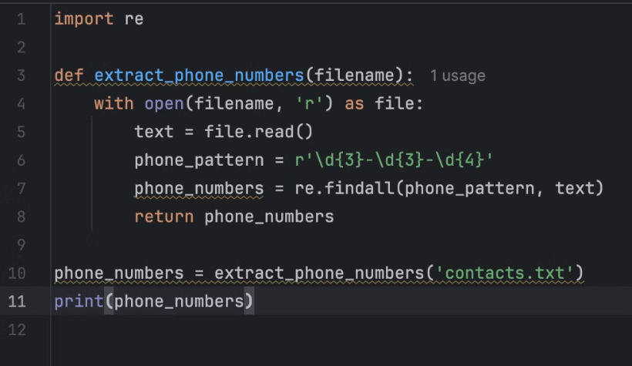
Hands-on Activity on regex
Task: Write a script to extract email addresses from a log file using regex.
Steps:
  Use the appropriate module.
  Define a function with regex pattern for your task.
  Call the function by passing in the file along with its path.
  Print the result.
Mohammad Anees Alam
Notes:
9

Slide 10
Practical Exercise: TaskManager Class
Let's analyze an all-in-one python code that involves OOP, regex and libraries concept.
Create a TaskManager class that:
  Executes system commands.
  Logs the output.
  Uses regex to parse logs for specific patterns like errors or warnings.
1
2
3
4
Execute Commands
Log Outputs
Parse for Patterns
Take Action
Run system commands with subprocess
Store command outputs in logs list
Use regex to find errors/warnings
Respond based on detected patterns
Mohammad Anees Alam
Notes:
10

